Slide 1

EV charging infrastructure for Heavy Duty Vehicles - Global and Indian perspective
By
Aditya Kumar
(Roll no. 24M1355)
M.Tech (1st year)
Under the guidance of
Prof. Zakir Hussain Rather
Department of Energy Science and Engineering
Indian Institute of Technology Bombay, Powai, 400076
Sept 2024

Slide 2

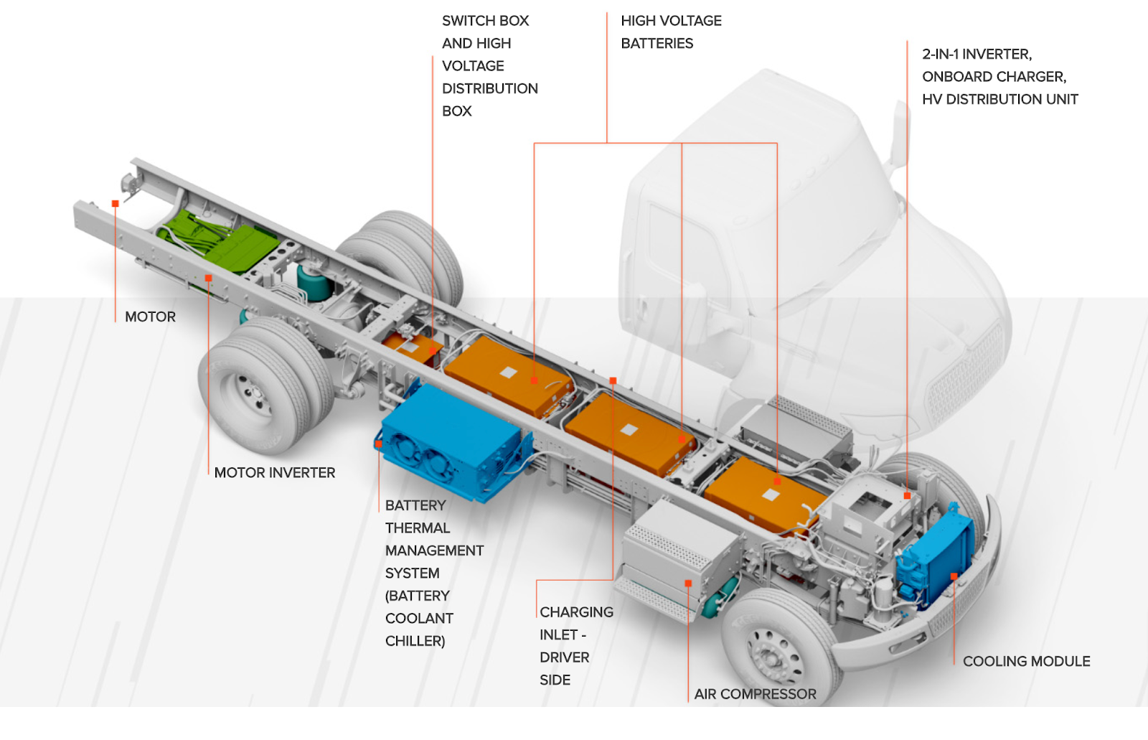
Heavy duty EV structure
Source: westruck.com, access date: 29/09/2024

Slide 3
Types of EV charging
Based on power flow
Based on use
Based on connector type
Based on process
Based on charging speed
Conductive
On-board
Off-board
Public
AC charging
Type 1
Type 2
CCS
Unidirectional
Slow
Wireless
Inductive
Capacitive
Private
DC charging
CHAdeMo
CCS
Tesla superchargers
Bi-directional
Medium
Battery swapping
Semi-public
Fast

Slide 4
Charging modes of EVs
Charging Mode | Charging Type | Maximum Current | Maximum Power | Charging Time for 50kWh | Kms from a 15 min Charge⁽¹⁾
Mode 1 | Slow | 16 A, AC, 1-ɸ | 3.7 kW | 14 h | 5 km
Mode 2 | Fast | 32 A, AC, 1-ɸ | 7.4 kW | 7 h | 9 km
Mode 3 | Rapid | 62 A, AC, 3-ɸ | 22 kW | >2 h | 27 km
Mode 4 | Ultra-Rapid | 400 A, DC, 3-ɸ | 200 kW | 15 min ⁽²⁾ | 250 km ⁽²⁾
^{(1).}Using an average consumption of 0.20 kWh/km.
^{(2).}Batteries cannot be fully charged at maximum power.
Source: Wireless Power Transfer Technologies Applied to Electric Vehicles: A Review - Scientific Figure on ResearchGate. Available from: https://www.researchgate.net/figure/Charging-modes-according-to-IEC-61851-1-7_tbl1_350014393 [accessed 23 Nov 2024]

Slide 5
Charging levels of EVs
Standard | Level | Voltage (V) | Current (A)
IEC 62196 | AC level 1 | 120 | 16
 | AC level 2 | 240 | 32
 | AC level 3 | 250 | 32-250
 | DC level 1 | 600 | 400
IEC 61851 | AC level 1 | 120 | 16
 | AC level 2 | 240 | 80
 | DC level 1 | 200-450 | 80
Charging levels as per IEC 62196 and IEC 61851
Source: NITI Aayog (2021). Report 1: Fundamentals of electric vehicle charging technology and its grid integration. NITI aayog India

Slide 6
HDV classification presented by *EPA guidelines
Vehicle Category | Abbreviation | *GVWR (in tons)
Light heavy-duty vehicles | HDV 2b | 4.25 – 5
 | HDV 3 | 5 – 7
 | HDV 4 | 7 – 8
 | HDV 5 | 8 – 9.75
Medium heavy-duty vehicles | HDV 6 | 9.75 – 13
 | HDV 7 | 13 – 16.5
Heavy heavy-duty vehicles | HDV 8a | 16.5 – 30
 | HDV 8b | >30
*GVWR - Gross vehicle weight rating
*EPA - Environmental Protection Agency
Source: EPA, vehicle weight classifications for the emission standards reference guide, United States EPA, 2017

Slide 7
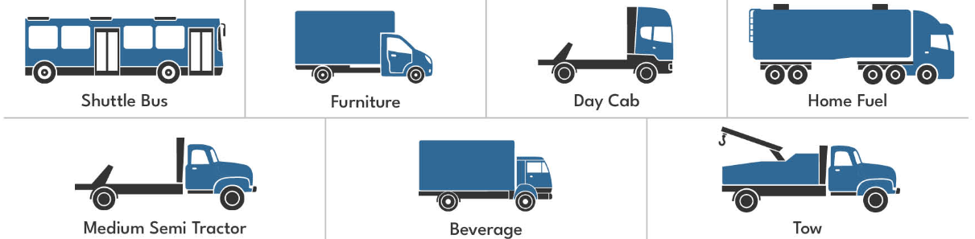
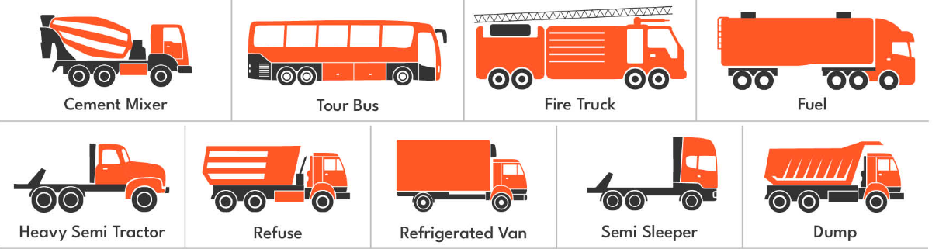
Classification of heavy duty vehicles
Class 7 (26001 – 33000 lbs.)
Class 8 ( more than 33001 lbs.)
Source: U.S. Department of Energy, Alternative fuels and data center, June 2012

Slide 8
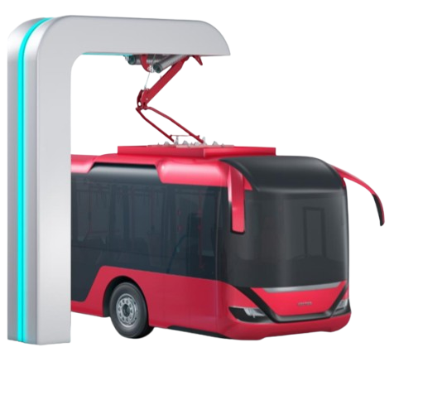
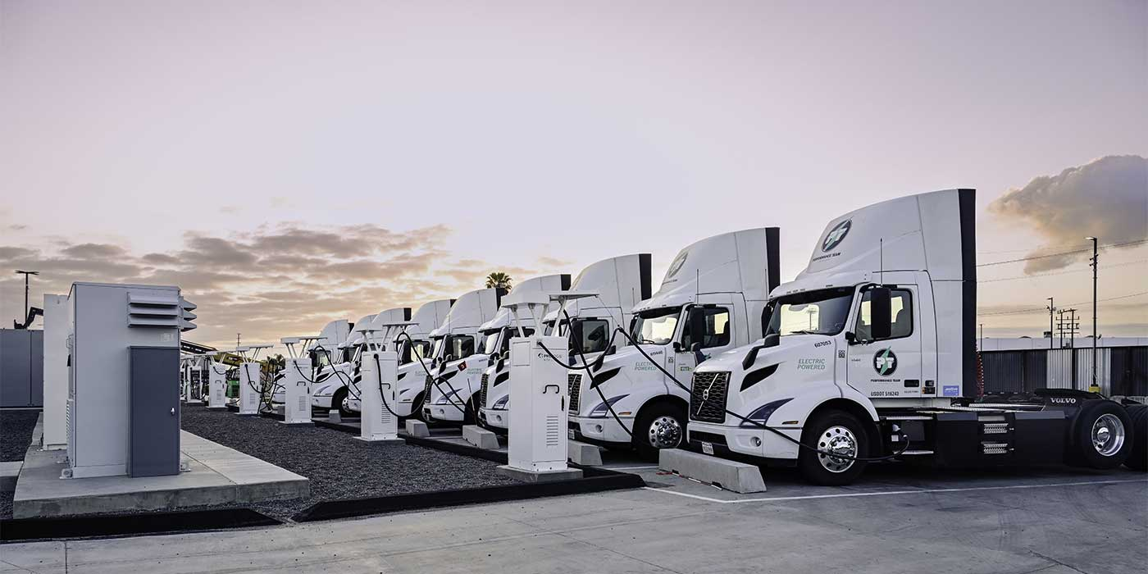
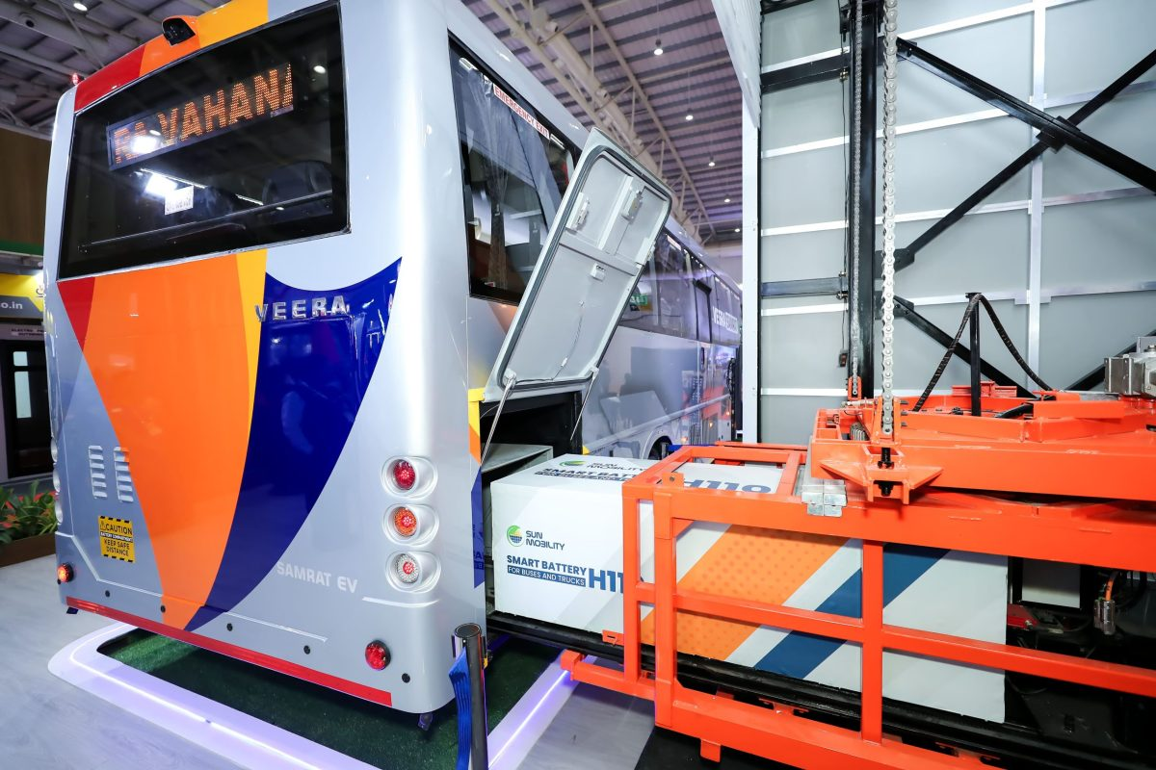
Classification of HDEVs based on different parameters
Charging type
Battery capacity
Range
Pantograph charging
Depot charging
Battery swapping
Tesla Semi
(900 kWh)
Ashok Leyland
(150 to 350 kWh)
Tesla Semi
(483 to 805 kms)
Olectra-BYD
(100 to 150 kms)
Source: https://indiaesa.info/images/articles/intro/E-bus_chrger.png
https://s18391.pcdn.co/wp-content/uploads/2024/06/Prologis-Mearck-charging-depot-3-1400.jpg
https://shorturl.at/u8YkT

Slide 9
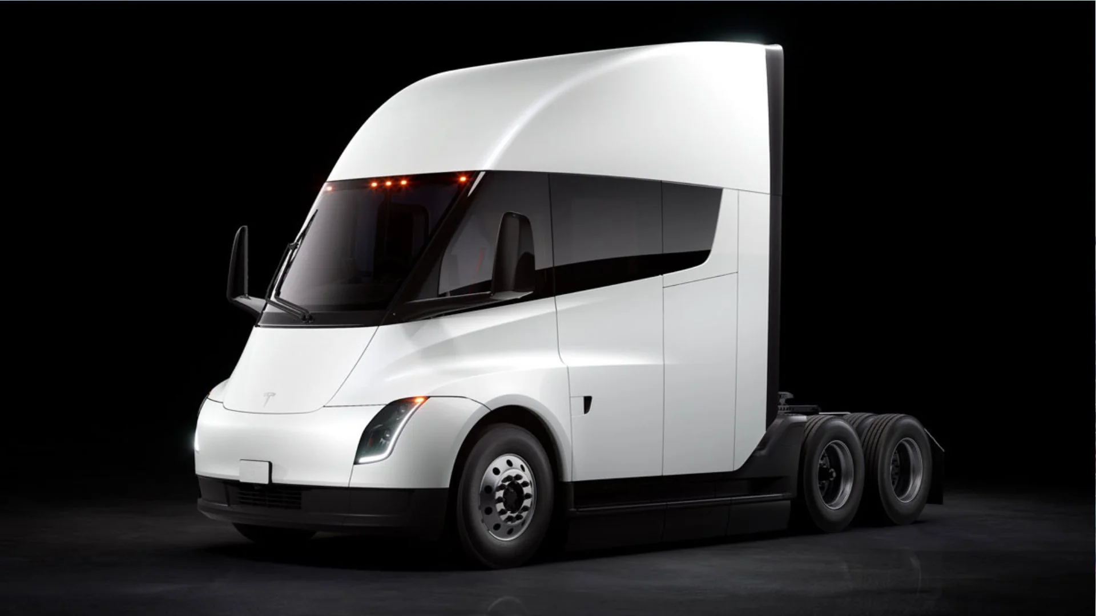
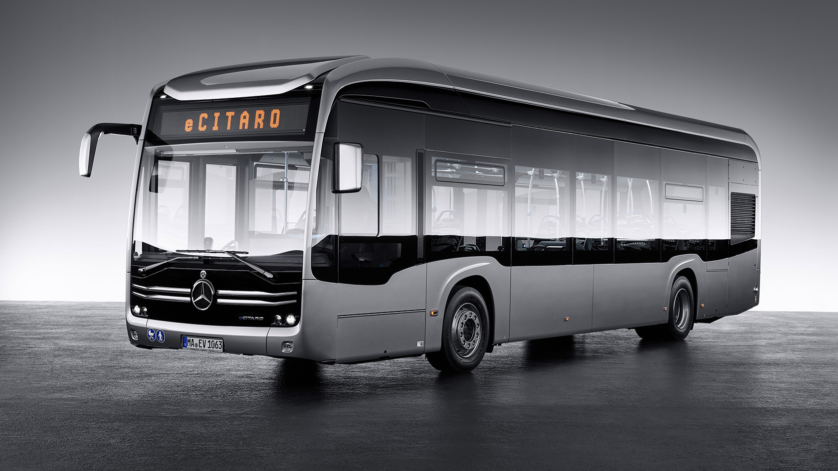
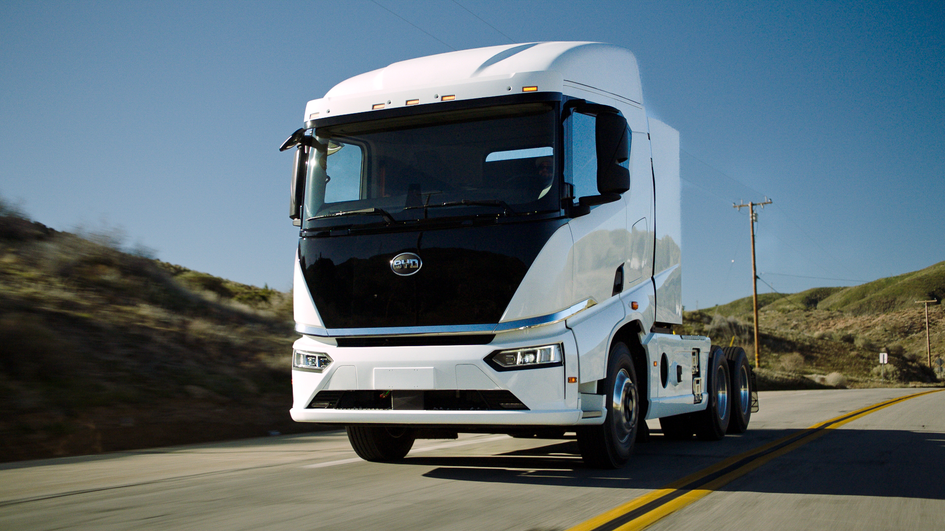
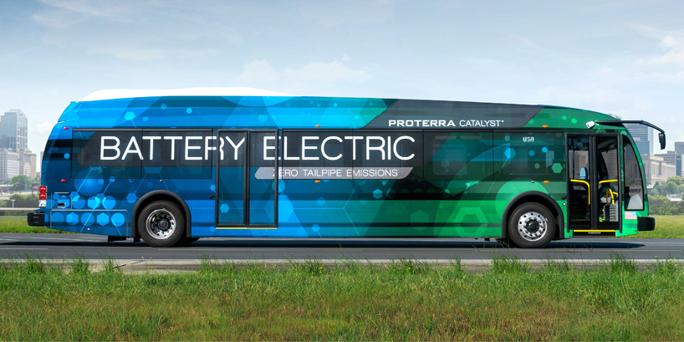
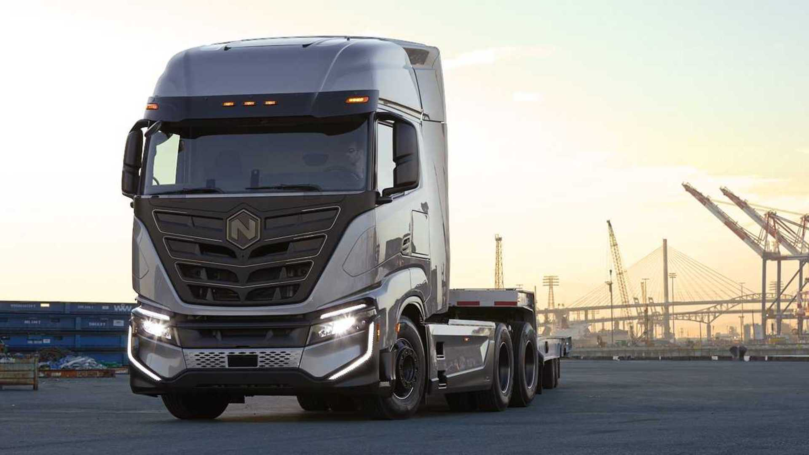
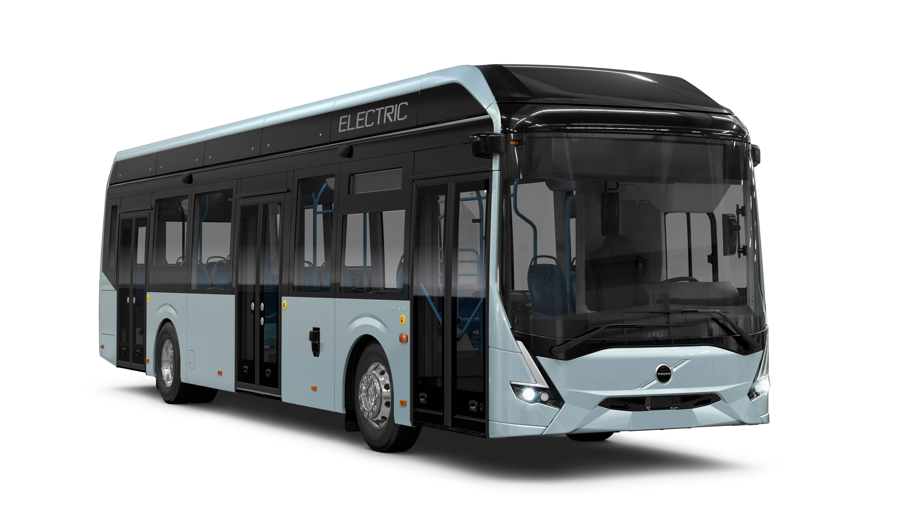
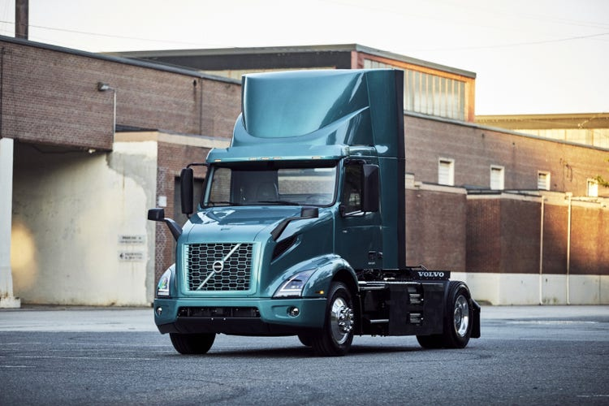
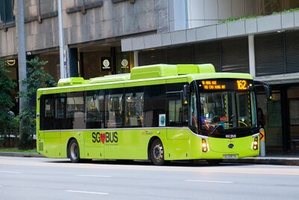
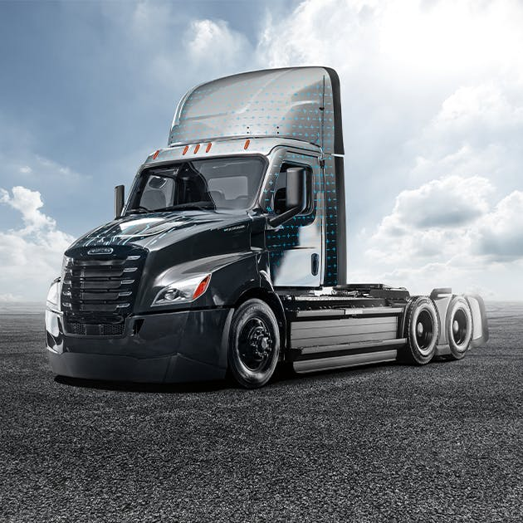
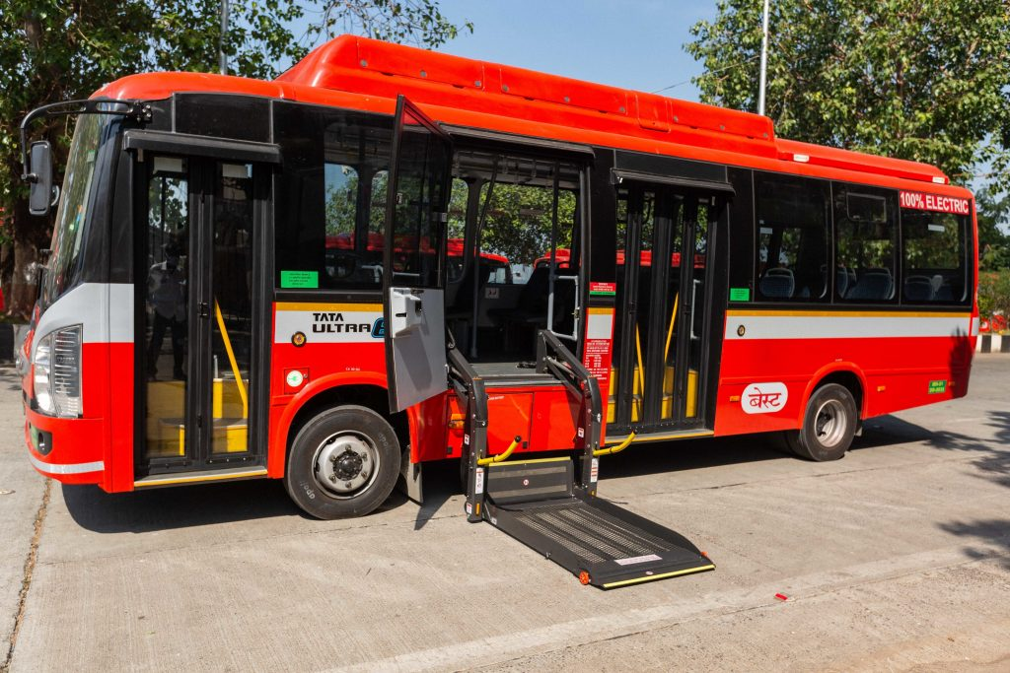
Globally available heavy-duty electric vehicles
Mercedes-Benz eCitaro
Tesla Semi
BYD 8TT
Proterra Catalyst
Nikola Tre BEV
Volvo 7900 Electric
Volvo VNR Electric
BYD K9
Freighliner eCascadia
Tata Ultra

Slide 10
Globally available heavy-duty electric vehicles 1. Electric trucks
Tesla Semi
Freightliner eCascadia
Volvo VNR Electric
Nikola Tre BEV
BYD 8TT
Range: 300-500 miles
Range: 230 miles
Range: 150–275 miles
Range: 330 miles
Range: 125 miles
Battery capacity: 900kWh
Battery capacity: 550kWh
Battery capacity: 264-565 kWh
Battery capacity: 733 kWh
Battery capacity: 422 kWh
Charging type: DC fast charging
Charging type: DC fast charging
Charging type: DC fast charging
Charging type: DC fast charging
Charging type: DC fast charging
[5], [6], [7]

Slide 11
2. Electric buses
Tata Ultra Electric Bus
Proterra Catalyst E2 Max
Volvo 7900 Electric
Mercedes-Benz eCitaro
BYD K9
Range: 124 miles
Range: 350miles
Range: 200 miles
Range: 124-186 miles
Range: 155 miles
Battery capacity: 250 kWh
Battery capacity: 660 kWh
Battery capacity: 300 kWh
Battery capacity: 292-441 kWh
Battery capacity: 324-348 kWh
Charging type: Depot charging
Charging type: Depot charging (DC fast charging)
Charging type: Pantograph charging
Charging type: DC fast charging
Charging type: DC fast charging
[8], [9]

Slide 12
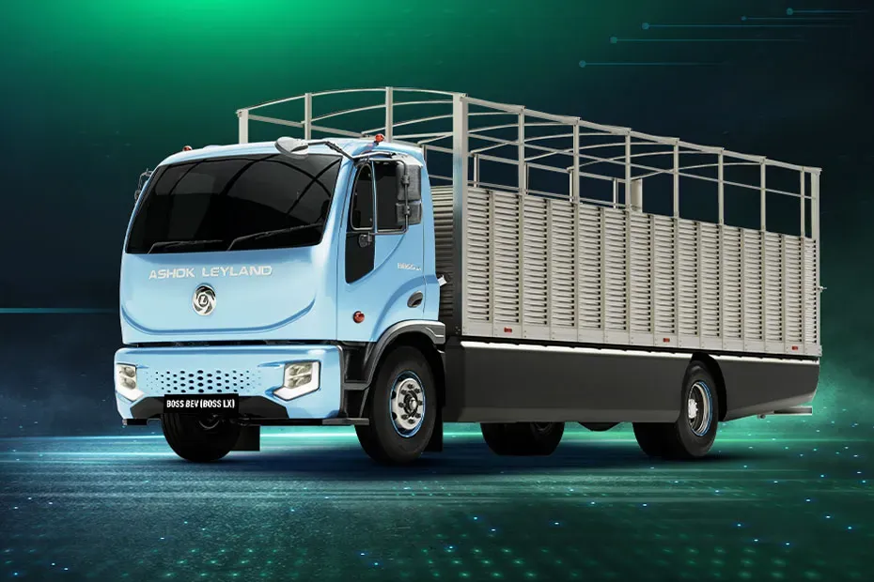
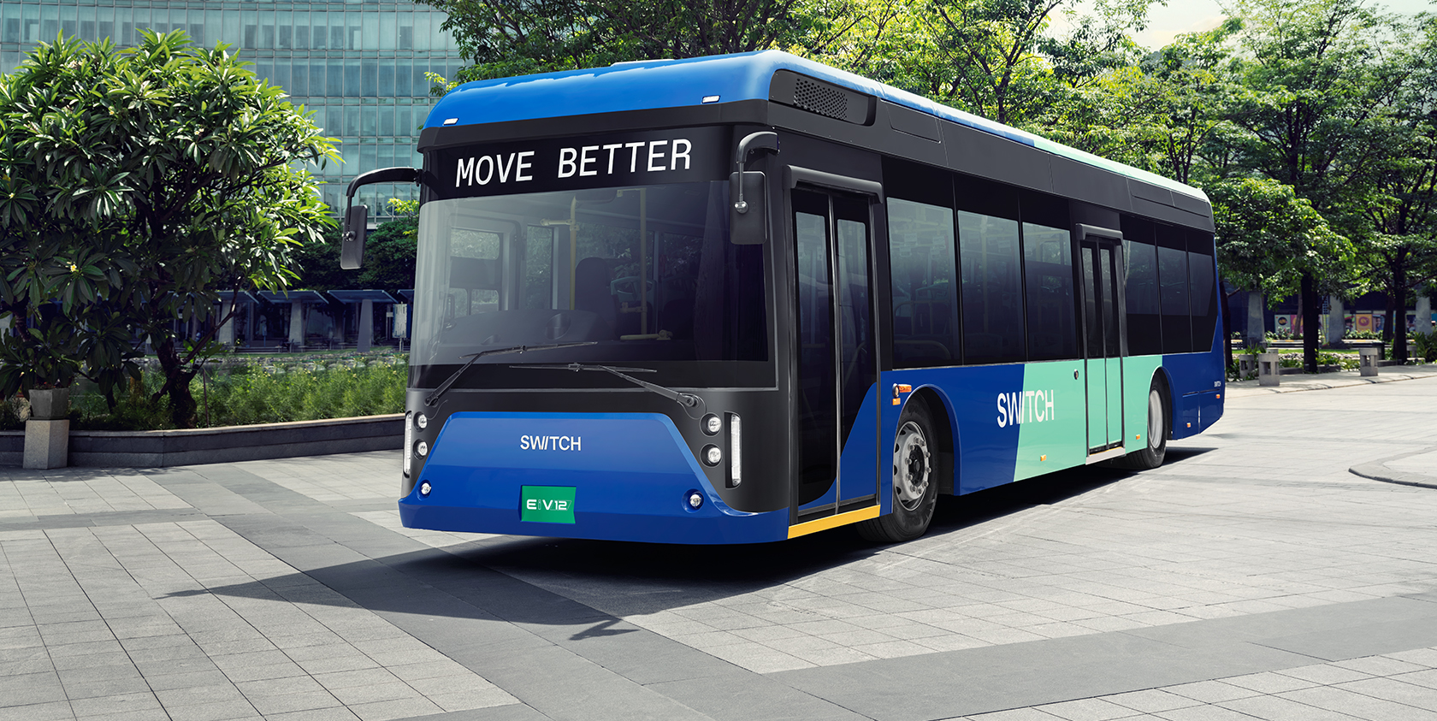
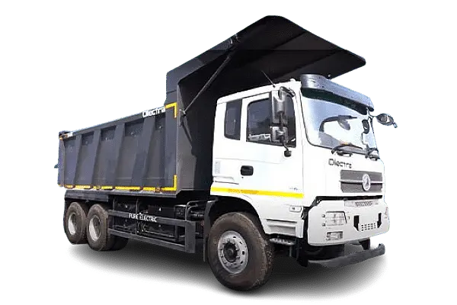
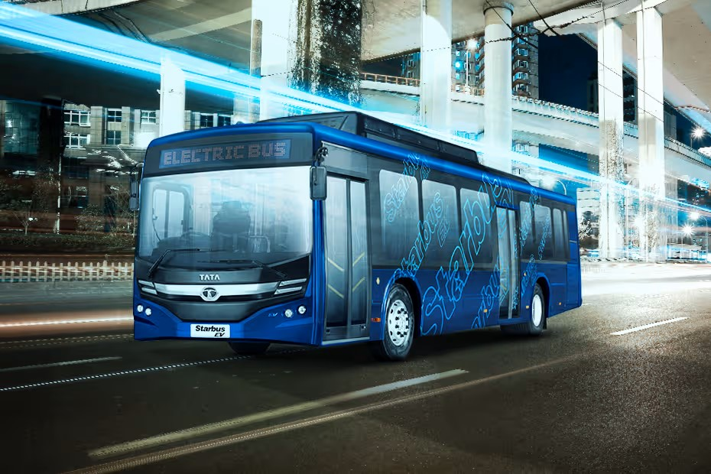
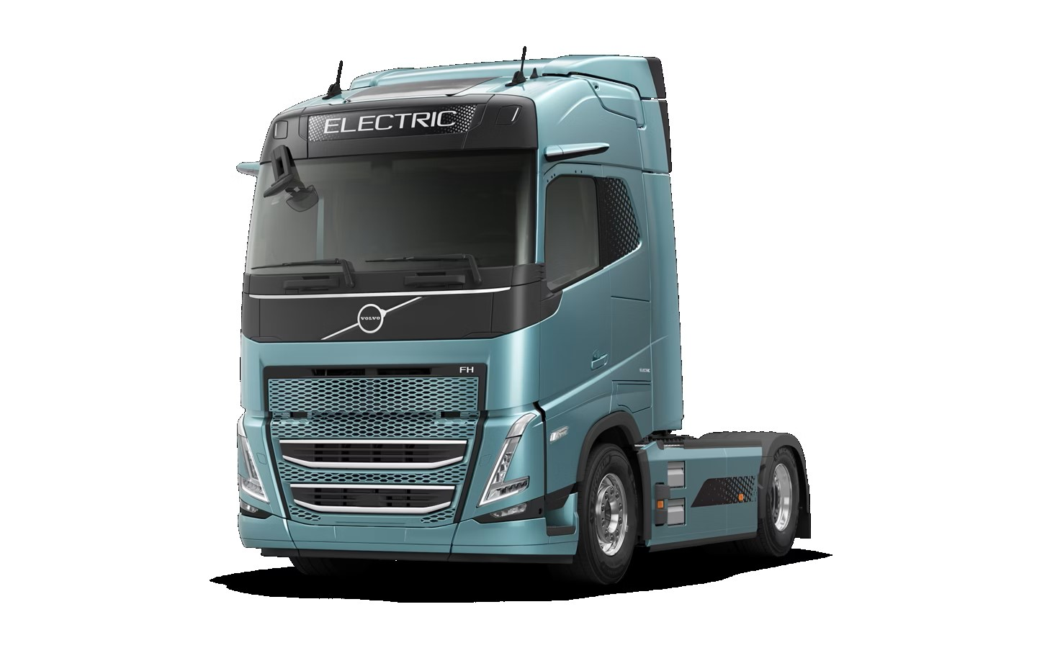
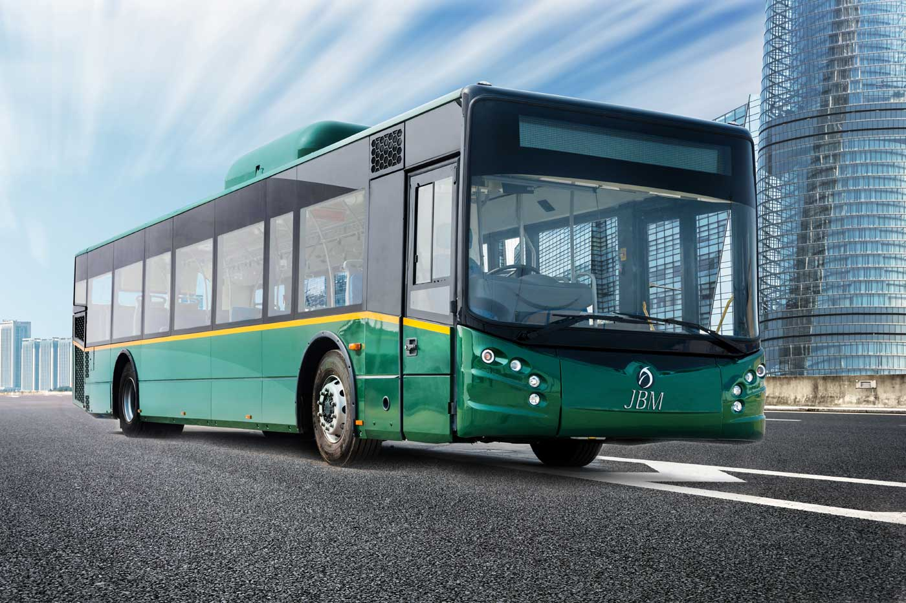
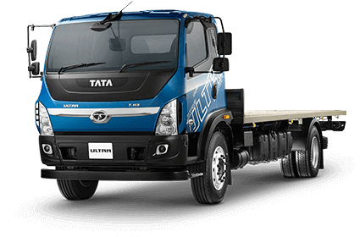
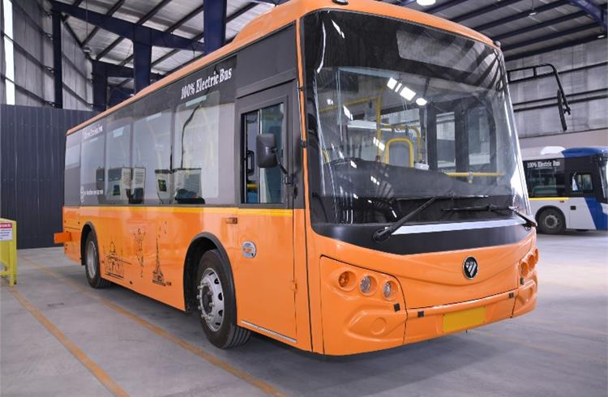
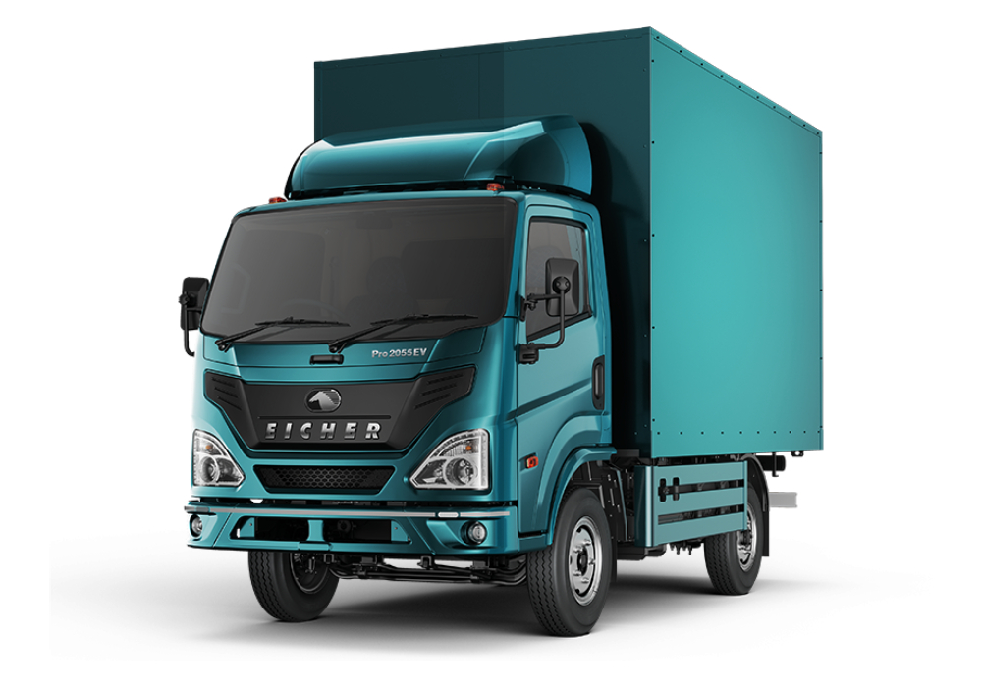
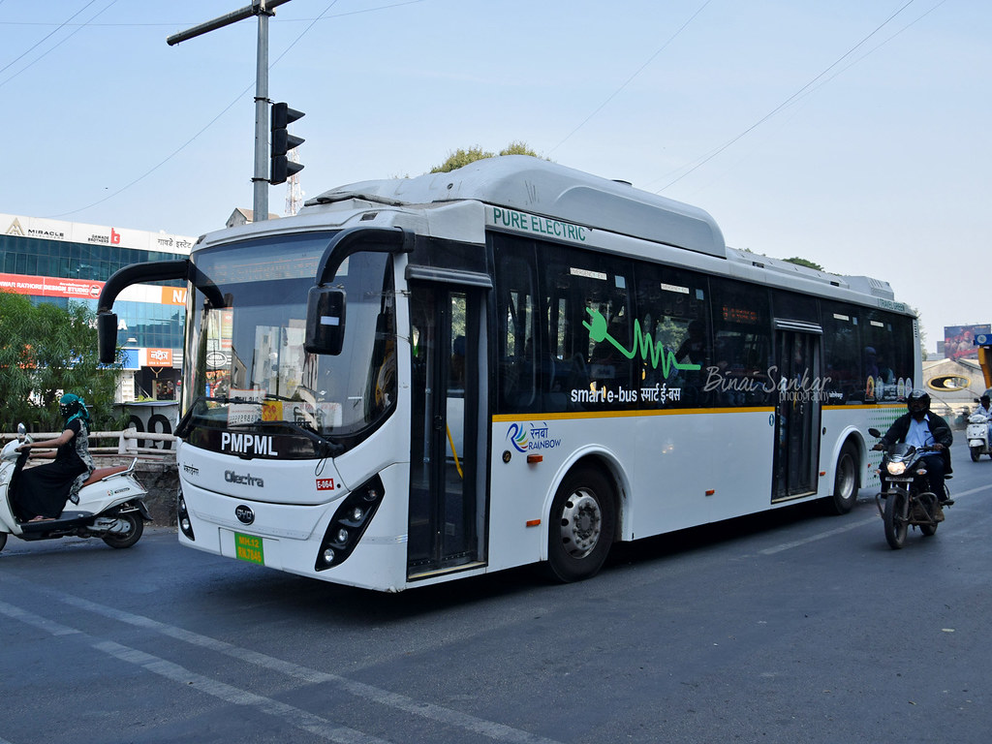
Heavy duty electric vehicles available in India
Ashok Leyland BOSS 1218
Switch EiV12
Tata Starbus Electric
Olectra 6x4 Electric Tipper
JBM ECO-LIFE Electric
Volvo FH Electric
Tata Ultra T.7 Electric
PMI Electro Mobility Y6
Eicher Pro 2055
Olectra K9

Slide 13
Heavy duty electric vehicles available in India 1. Electric trucks
Tata Ultra T.7 Electric
Olectra 6x4 Electric Tipper
Volvo FH Electric
Eicher Pro 2055 EV
Ashok Leyland BOSS 1218 HB
Range: 100-150 km
Range: 70-110 km
Range: up to 300 km
Range: 150-200 km
Range: 300-350 km
Battery capacity: 62.5 kWh
Battery capacity: 350 kWh
Battery capacity: 360-540 kWh
Battery capacity: 64 kWh
Battery capacity: 80% in 1 hour
Charging type: DC fast charging (CCS2)
Charging type: DC fast charging (CCS2)
Charging type: AC, DC fast charging (CCS)
Charging type: DC charging (CCS2)
Charging type: DC fast charging (CCS2)
[11], [12]

Slide 14
2. Electric buses
Tata Starbus Electric
JBM ECO-LIFE Electric
Olectra K9
Switch EiV12
PMI Electro Mobility Y6
Range: 150-200 km
Range: 120-250 km
Range: 300-350 km
Range: 100-500 km
Range: 180-240 km
Battery capacity: 186 kWh (expandable)
Battery capacity: 261 kWh
Battery capacity: 324 kWh
Battery capacity: 111-460 kWh
Battery capacity: 250 kWh
Charging type: Fast charging (CCS2)
Charging type: AC and DC (CCS2)
Charging type: Fast charging (CCS2)
Charging type: DC fast charging (CCS2)
Charging type: DC fast charging (CCS2)
[13], [14]

Slide 15

Challenges of HDEV charging infrastructure
Range and charging time
Impact of EV charging on the grid and power system reliability
Return to Base model charging infrastructure
Complexities in EV battery technology
EV battery degradation and aging
Charger cost
Daily operational schedules of commercial electric vehicles
Utilization rates of public charging infrastructure
Source: Yousuf A.K.M., Wang Z., Paranjape R., Tang Y., 2024. An in-depth exploration of
electric vehicle charging station infrastructure: A comprehensive review of challenges,
mitigation approaches, and optimization strategies. IEEE Access 12, 51570–51589.
Image: https://unsplash.com/photos/grayscale-photo-of-cars-on-road-nbRgZltoOck

Slide 16
Challenge 1. Range and Charging Time
Limited range
- Current models have a range of about 200–300 km per charge,
insufficient for long-haul operations.
Charging time
- High battery capacity (ranging from 200 to 500 kWh for HDVs)
- Can take up to 1–2 hours.
Solution
Megawatt chargers (Ultra-fast chargers)
- Can bring charging times down to 30–45 minutes.
Battery swapping
Battery energy storage systems (BESS) integrated with charging stations
Source: Sachan S., Singh P. Charging infrastructure planning for electric vehicle in India: Present status and future challenges, Regional Sustainability, Volume 3, 2022
Zähringer M., Zohm F. & Peteranderl C. Megawatt Charging for Battery-electric Trucks in Long-haul Transport. ATZ Worldw 125, 36–41 (2023)

Slide 17
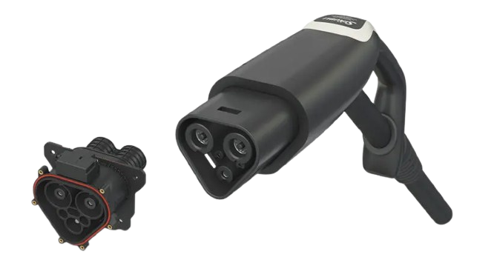
Megawatt Chargers
Here are the key details related to Megawatt charging -
Charging Power
Delivers up to 3.75 MW of charging power theoretically
Extremely fast charging of heavy-duty electric vehicles
Standard Combined Charging System (CCS) offers around 350 kW of power
Impact on Downtime
When charging with 700 kW using MCS, time losses compared to CCS can be reduced to less than 20 minutes.
With further battery and charging technology improvements, the time loss could decrease to an average of less than 10 minutes per charging session.
Source: Sachan S., Singh P. Charging infrastructure planning for electric vehicle in India: Present status and future challenges, Regional Sustainability, Volume 3, 2022
Zähringer M., Zohm F. & Peteranderl C. Megawatt Charging for Battery-electric Trucks in Long-haul Transport. ATZ Worldw 125, 36–41 (2023)

Slide 18
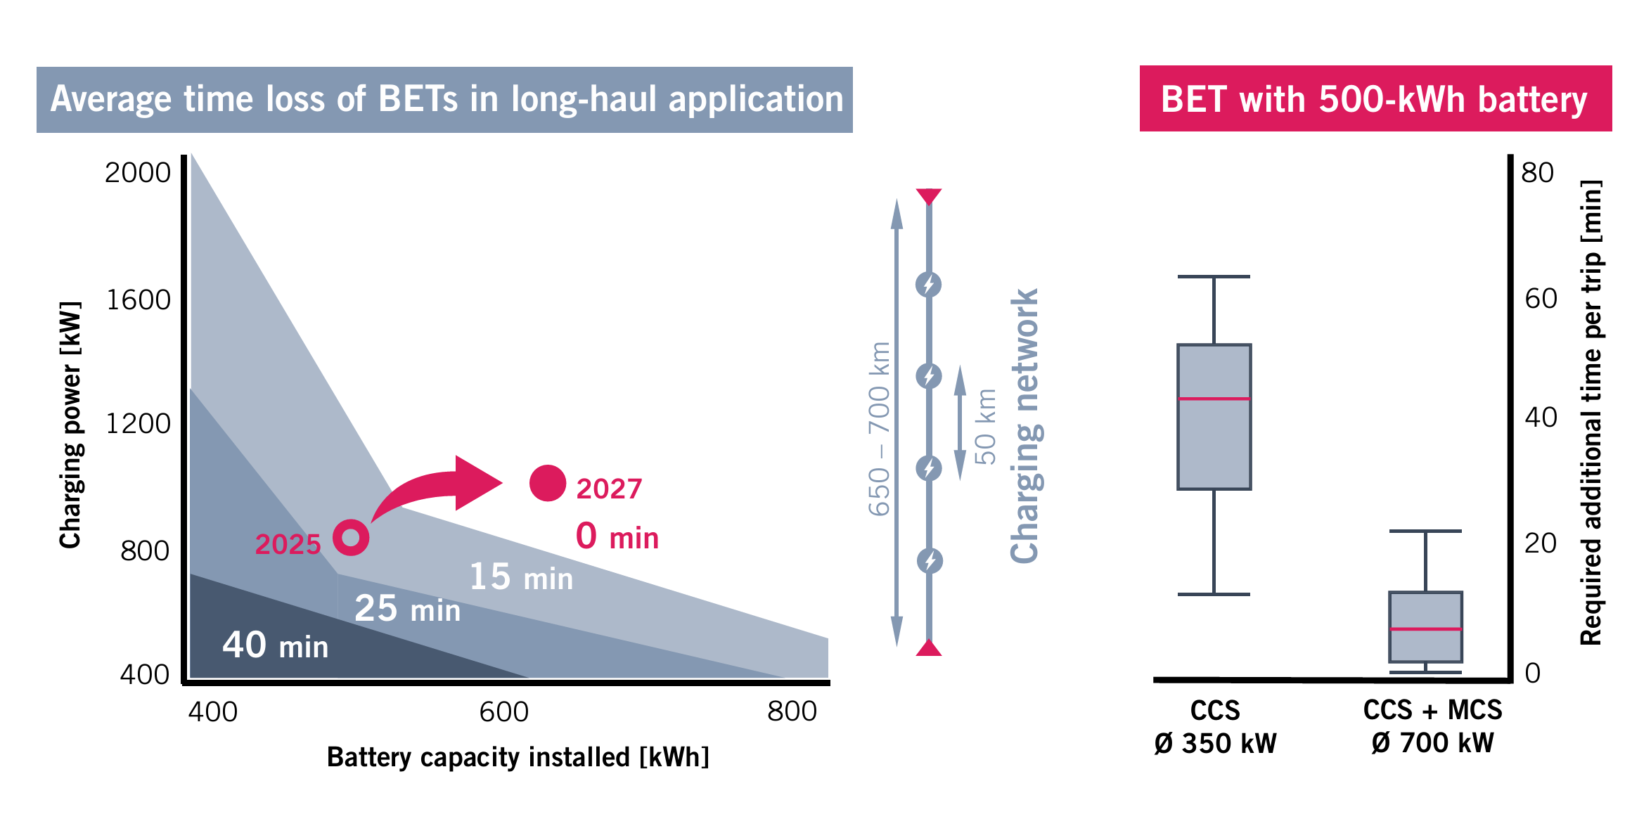
Caption: Time loss of BETs in longhaul transport compared to ICETs when using the public charging infrastructure accord ing to the expansion plan “Master Plan Charging Infrastructure” (© MAN, TUM)
Source: Zähringer M., Zohm F. & Peteranderl C. Megawatt Charging for Battery-electric Trucks in Long-haul Transport. ATZ Worldw 125, 36–41 (2023)

Slide 19
Challenge 2: Impact of EV charging on the grid
Undesired voltage profile (voltage drop, voltage unbalance etc.),
Power loss (demand-generation mismatch),
Frequency issues (unstable frequency and harmonic distortion etc.),
Rural or remote areas - Limited grid availability
Solution
Grid Impact mitigation strategy:
PV-ES-Charger solution
PV-ES-Charger sizing strategy
Source: Zhu, X., Mishra, P., Mather, B., Zhang, M., & Meintz, A. (2023). Grid impact analysis and mitigation of en-route charging stations for heavy-duty electric vehicles. IEEE Open Access Journal of Power and Energy, 10, 141-150.

Slide 20
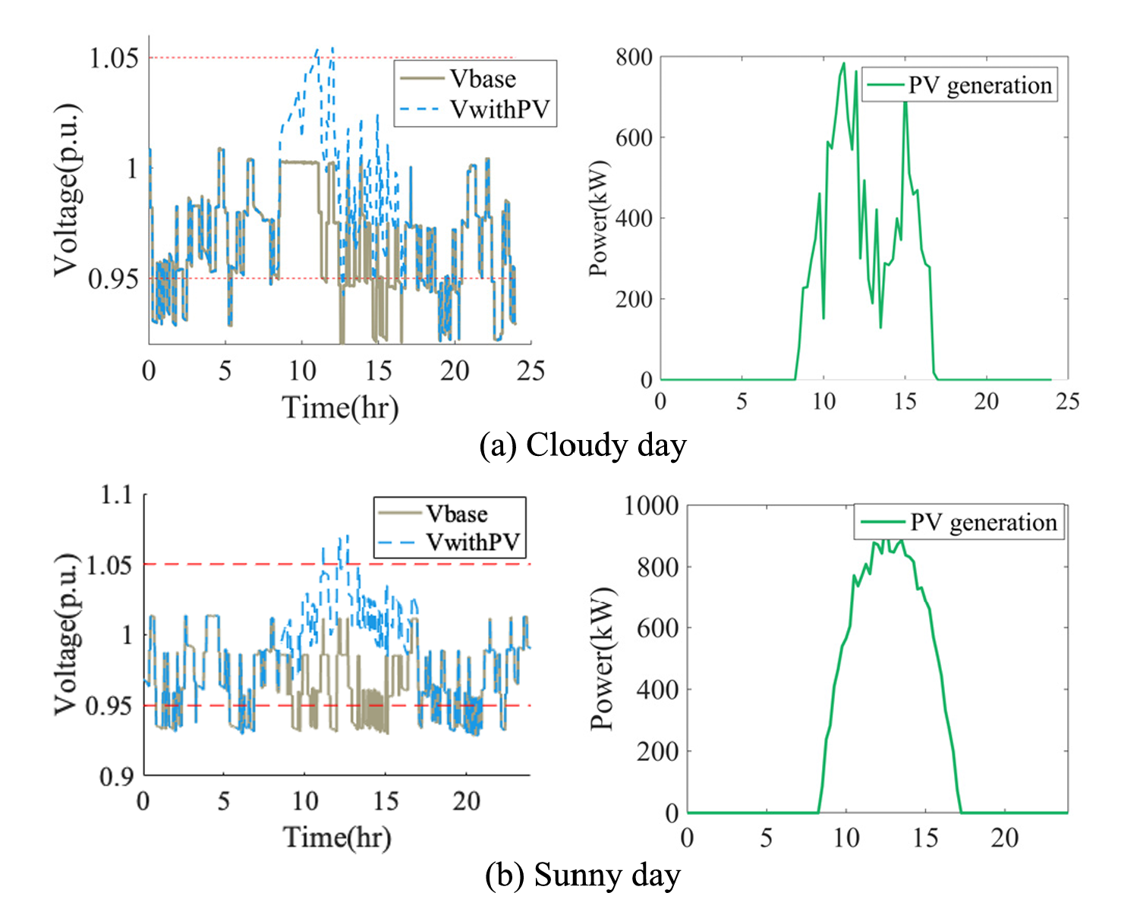
1. PV-ES-Charger solution:
Reactive Power Support: Boosts voltage
but ineffective under high charging load;
needs on-site generation.
PV + Energy Storage: Balances load;
stores excess PV power and supports
during low PV generation.
Challenges:
Cloudy days: PV and load misaligned.
Sunny days: Excess PV raises voltage.
Design: Optimize PV, storage, and inverter sizes for stability and efficiency.
Source: Zhu, X., Mishra, P., Mather, B., Zhang, M., & Meintz, A. (2023). Grid impact analysis and mitigation of en-route charging stations for heavy-duty electric vehicles. IEEE Open Access Journal of Power and Energy, 10, 141-150.

Slide 21
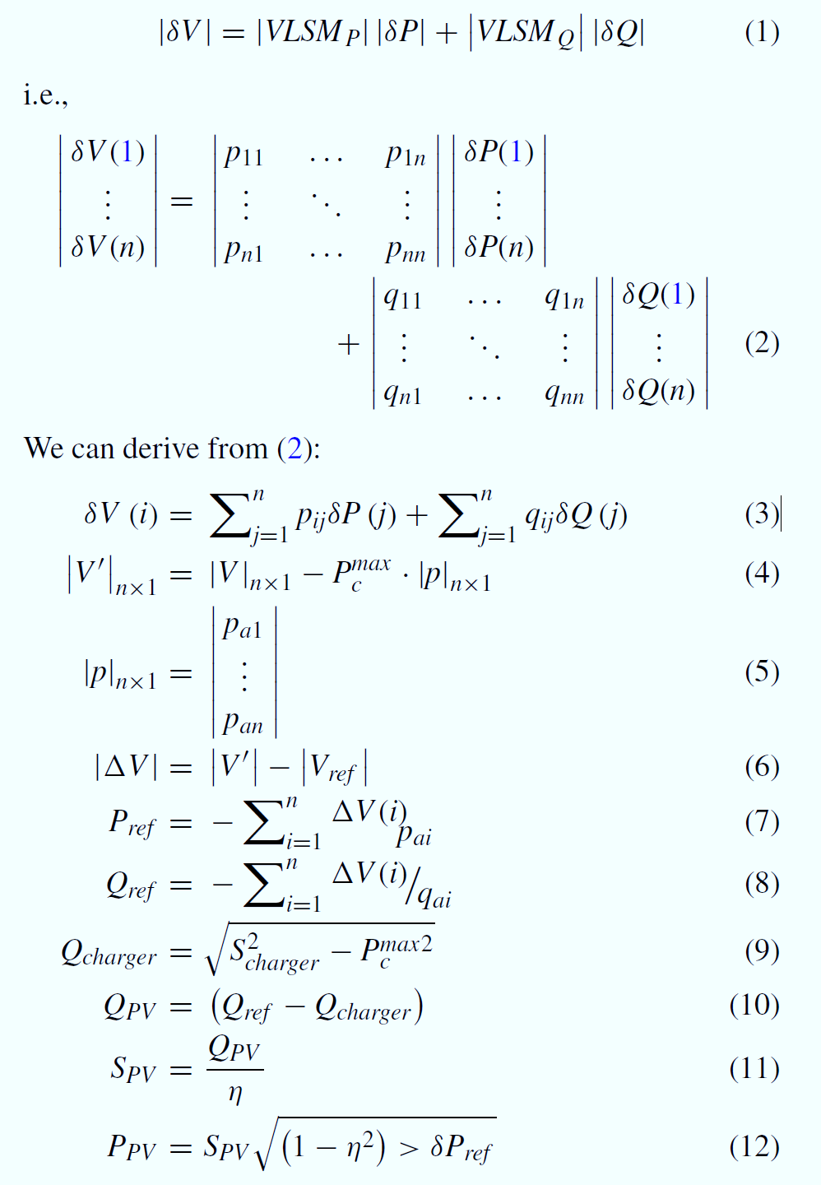
2. PV-ES-Charger sizing strategy:
Key Objectives
🎯 Maintain System Voltage Stability
💰 Minimize Total Capital Cost
Core Methodology
🧮 Voltage Load Sensitivity Matrix (VLSM): Predict voltage changes due to power variations.
⚡ Real/Reactive Power Calculation: Ensure system voltage aligns with reference values under peak load.
🔧 Component Sizing: Optimize PV, Energy Storage (ES), and Charger sizes for cost efficiency.
Energy Storage (ES) Role
🔋 Store Excess PV Power:
Supplies power during low PV generation.
📊 Sized by Interaction:
Uses PV Generation & Charging Load Profiles.

Slide 22
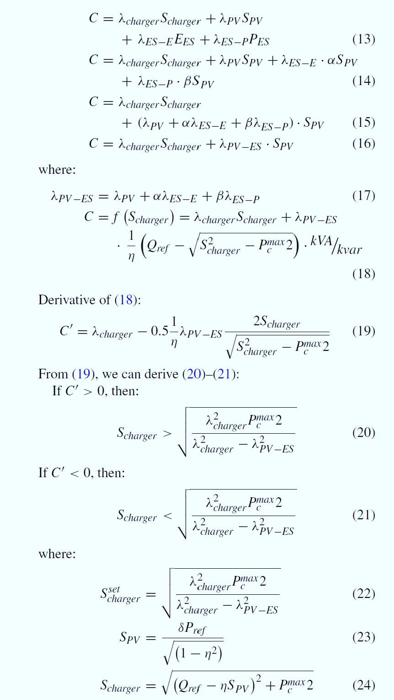
Optimization Insights
📈 Coefficients (α & β): Represent the PV-ES relationship through empirical data.
💵 Cost Function: Balances PV, ES, and Charger sizes for lowest cost.
Conclusion
Total Cost: Adopt if the total capital cost is competitive with alternatives.
Charger Cost: Favor adoption if charger cost is comparable to or lower than PV-ES system cost.
Source: Zhu X., Mishra P., Mather B., Zhang M., & Meintz A. (2023). Grid impact analysis and mitigation of en-route charging stations for heavy-duty electric vehicles. IEEE Open Access Journal of Power and Energy, 10, 141-150.

Slide 23
References
NITI Aayog (2021). Report 1: Fundamentals of electric vehicle charging technology and its grid integration. NITI aayog India
https://coachbuildersindia.com/commercial-vehicle-battery-swapping-sun-mobility/ Access date: 29/09/2024
Lajunen, A. (2018). Energy Consumption and Cost-Benefit Analysis of Hybrid and Electric City Buses. Transportation Research Part C: Emerging Technologies, 94, 52-67.
Moultak, M., Lutsey, N., & Hall, D. (2017). Transitioning to Zero-Emission Heavy-Duty Freight Vehicles. ICCT Report
Zheng, Y., Mehndiratta, S., Guo, J., & Liu, Z. (2015). Strategic Planning of Electric Buses in Large Cities. Energy Journal, 88, 584-594.
Shams Ashkezari L., Kaleybar H.J., Brenna, M., 2024. Electric bus charging infrastructures: Technologies, standards, and configurations. IEEE Access 12, 80505–80528.
Tata Motors (2023). Electric Mobility Solutions. Tata Motors Technical Papers
Volvo Trucks (2021). Electric Truck Solutions for a Sustainable Future. Volvo Technical Report
BYD Auto Co. Ltd. (2021). BYD 8TT Electric Truck. Retrieved from: https://en.byd.com/truck Access date: 29/09/2024
Tata Motors. (2022). Tata Ultra Electric Bus Specifications. Retrieved from: https://www.tatamotors.com Access date: 30/09/2024
Volvo Buses. (2021). Volvo 7900 Electric Specifications. Retrieved from: https://www.volvobuses.com Access date: 30/09/2024
Zhu, X., Mishra, P., Mather, B., Zhang, M., & Meintz, A. (2023). Grid impact analysis and mitigation of en-route charging stations for heavy-duty electric vehicles. IEEE Open Access Journal of Power and Energy, 10, 141-150.
Yousuf A. K. M., Wang Z., Paranjape R., & Tang Y. (2024). An in-depth exploration of electric vehicle charging station infrastructure: a comprehensive review of challenges, mitigation approaches, and optimization strategies. IEEE Access.

Slide 24
Rivian Automotive. (2021). Amazon Electric Delivery Van. Retrieved from: https://rivian.com Access date: 30/09/2024
https://www.volvotrucks.com/en-en/trucks/electric/volvo-fh-electric.html Access date: 01/10/2024
https://wagenclub.com/2023/07/olectra-meghaetron-electric-tipper-review-technical-india.html Access date: 01/10/2024
https://www.itdp.in/wp-content/uploads/2022/10/Status-of-E-buses-in-India.pdf Access date: 02/10/2024
Electric Buses in India: Government funding and policies driving growth, October 26, 2022. https://reglobal.org/electric-buses-in-india-government-funding-and-policies-driving-growth/ Access date: 02/10/2024
https://www.rff.org/publications/reports/medium-and-heavy-duty-vehicle-electrification-challenges-policy-solutions-and-open-research-questions/ Access date: 02/10/2024
Sachan S., Singh P. Charging infrastructure planning for electric vehicle in India: Present status and future challenges, Regional Sustainability, Volume 3, 2022
https://doi.org/10.1016/j.regsus.2022.11.008
Zähringer, M., Zohm, F. & Peteranderl, C. Megawatt Charging for Battery-electric Trucks in Long-haul Transport. ATZ Worldw 125, 36–41 (2023) https://doi.org/10.1007/s38311-023-1504-0
Sugihara C., Hardman S., Kurani K. Social, technological, and economic barriers to heavy-duty truck electrification, Research in Transportation Business & Management, Volume 51, 2023 https://doi.org/10.1016/j.rtbm.2023.101064
https://pmedrive.heavyindustries.gov.in/docs/policy_document/257594.pdf Access date: 09/10/2024

Slide 25
Thank You

